Slide 1
LAKE BELTON BRONCOS
SOFTBALL 2024 HANDBOOK
“G ”
3
Notes:
Grit, Grind, and Greatness

Slide 2
Bronco Softball
Coaches:
Kelsie McEachern kelsie.mceachern@bisd.net
Rachel Ripley rachel.ripley@bisd.net
Jeremiah Adams jeremiah.adams@bisd.net
Twitter or X: Lake Belton Bronco Softball @LBBroncosSB
Remind Me: Next Page
GameChanger: Lake Belton Varsity Broncos & Lake Belton Junior Varsity Broncos

Slide 3
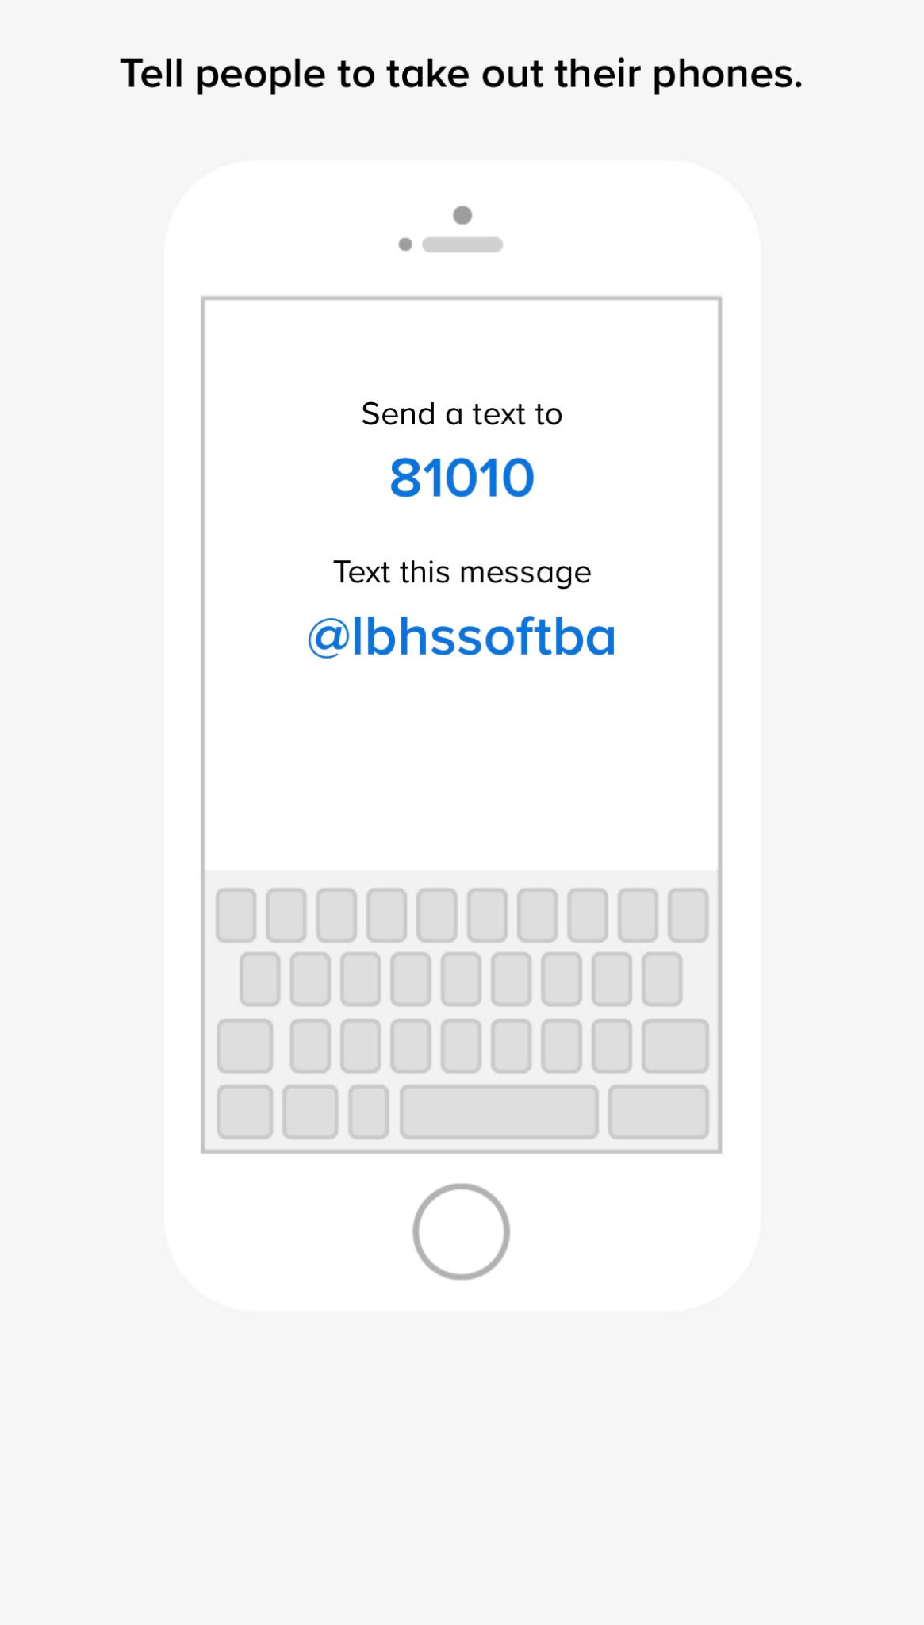

Slide 4
Parent & Coach Relationship
Forms of Communication:
Coach telling player
Remind Me
Twitter
Parent/Coach Meetings
Email
Athletic Website
Types of Information you will receive from coaches:
Expectations of your child as a player
Practice times and dates
Team requirements
Team rules & guidelines
Game times and locations and all changes that may arise
Types of Information coaches need from parents:
Information on illness or injury - - this will need to be relayed to the athletic trainer
Notification of scheduling conflicts
Concerns that you have should be expressed to the softball staff first.
Appropriate steps to resolve conflicts:
24 Hour Rule after Game
1st Step: Talk to your daughter
2nd Step: Coach & Player Conference Scheduled
3rd Step: Meeting with Coach/Player/Parent
4th Step: Meeting with Coach/Parent/Coordinator

Slide 5
Parent & Coach Relationship
Appropriate issues that will be discussed with the coaches:
The treatment of your daughter; ONLY YOUR DAUGHTER
Ways that can help your child improve
Concerns about your child’s behavior
Issues that will not be discussed with parents:
Practice Organization
Other Student/Athletes
Team Strategy
Playing Time
Parent Behavior Expectations:
Emphasize a healthy work ethic concentrated on improved performance, not winning. Winning will come with skill improvement.
Embrace your daughter’s role in the softball program and build up the importance of everyone contributing to the best of their ability with their given role.
Maintain control of your emotions at all games and events.
Be a positive role model. Be a positive FAN.
DO NOT APPROACH A COACH OR PLAYER FROM THE STANDS WHILE THEY ARE INVOLVED IN A COMPETITION. (EVEN THE DUGOUT) This includes before and after games.
Do not enter the playing field, dugout, or bullpen area, unless your child is injured.

Slide 6
Bronco Expectations
School
Players will attend all classes unless an excused note is approved from the office.
C’s are not our goal academically. WE WANT TO EXCEL IN THE CLASSROOM!
Poor behavior will not be tolerated on any part of campus.
Drugs
Players are not to be using at anytime: alcohol, drugs, or any synthetic variation of any illegal street drugs.
Players are not to share or solicit the sale of any prescribed drug.
Players are not to vape or use any other forms of tobacco.
The Belton ISD Student/Athletic Handbook will be followed.
Locker Room
Players are not to take any item out of another player’s locker; this includes team equipment along with personal items.
Use locker wisely; lock up valuables.
All locker room music will be edited/clean edition and the volume will be respectful to the other teams and coaches in the area.
Equipment
WE WILL BE A UNIFORMED GROUP IN ALL ACTIVITIES. If one person does not have it on, no one should.
Your equipment is to be put away in your locker each day.
Our equipment is not responsible for poor performance. Thrown equipment will be dealt with immediately.
Athlete is responsible for washing Game Day Uniforms. Except brand new uniforms.

Slide 7
Team Policies
Team Policy
Players ride to games and tournaments on the bus. May go home with parent/guardian on Friday games & Saturday tournaments if signed out. Players will ride to and from during playoffs.
Missed practices will need to be made up before the next game and could affect playing time.
Players are asked to put high school softball above club ball while in season.
Injury
Report all injuries to the trainer and coach before leaving practice.
All reported injuries that require treatment should be done in the trainer’s room.
Please talk to a coach or trainer before going to the Doctor about an injury.

Slide 8
Practice Requirements
Practice
PLAYERS MUST BE ON TIME!
PRACTICES ARE NOT TIMES TO PLAY! We will be focused and efficient.
Players should be at every practice unless officially excused by the coach, trainer, doctor, or your parent.
Players must contact coaches if they miss a practice.
If a player is injured and is limited in their movement, they must receive treatment from the trainer and remain at practice if the injury permits.
Players will wear matching practice shirts and pants; WE ARE A TEAM!

Slide 9
Game Day Requirements
Game Day
PLAYERS MUST BE ON TIME!
Players are expected to be in attendance for all games and stay until field maintenance is done.
Players should be at every game unless officially excused by the coach, trainer, or doctor.
Players must contact coaches if they are going to miss a game.
Players are expected to wear game day attire; WE ARE A TEAM!

Slide 10
Signature Page
Review Handbook
By signing this page, you are agreeing to abide by the standards of the Lake Belton Softball Program. You have reviewed the expectations and understand that if you do not adhere to these standards/expectations that necessary actions will be taken upon at coach's discretion.
Please return this page and a copy will be given to you.
Player’s Signature: ________________________________________ Date: ___________
Parent’s Signature: ________________________________________ Date: ___________

Slide 11
Questions
If you have any questions or concerns please contact via email or you may come to the front:
kelsie.mceachern@bisd.net
New Website:
https://www.lakebeltonathletics.com/
New App:
Belton ISD Athletics

